Slide 1


Java Embedded Project
B.Selvamareeswaran.
P.Meenatchisundaram.

Slide 2


Table of contents
Introduction
Tools Used
About the Project
Softwares Used
Simple Usecase Diagram
About Application Modules

Slide 3
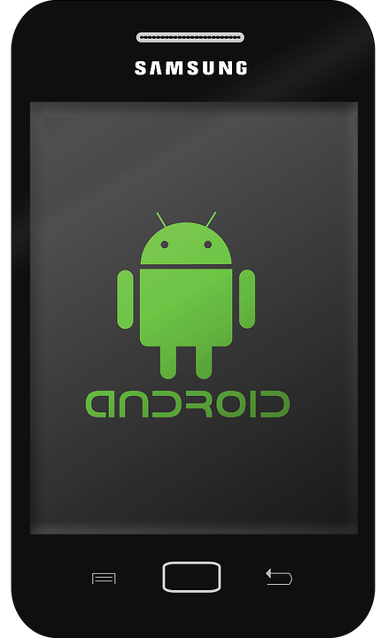
Introduction
In this project , I am going to develop a Android Mobile chat application.
In this App , We can do private chats and group chats also.
Application name : DOCHAT

Slide 4




Tools Used
Front-end → XML
Back-end → JAVA
DBMS → FIREBASE
Notifications → JS

Slide 5
About The Project
Design and develop a android mobile chat application.
XML is used as front-end tool to create UI’s.
JAVA is used as back-end tool to do back-end tasks.
FIREBASE is used as DBMS for the real-time data manipulation.
JAVASCRIPT is used for App notification feature.

Slide 6


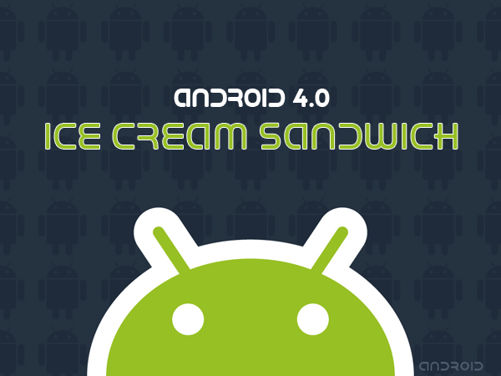
Software Used
Android Studio 2019
Firebase
Visual Studio Code
Android Sdk (Icecream sandwich 4.0)

Slide 7

Simple usecase diagram
Signup
Login
Do private & group chat
Find Friends
Update Profile
Member
Everyone
Send Request
Create Group

Slide 8
About Application Module
Login
Signup
Forgot password
Home UI
Menus
User profile
Find friends
Create group
Chat UI
Group info
Friend request

Slide 9
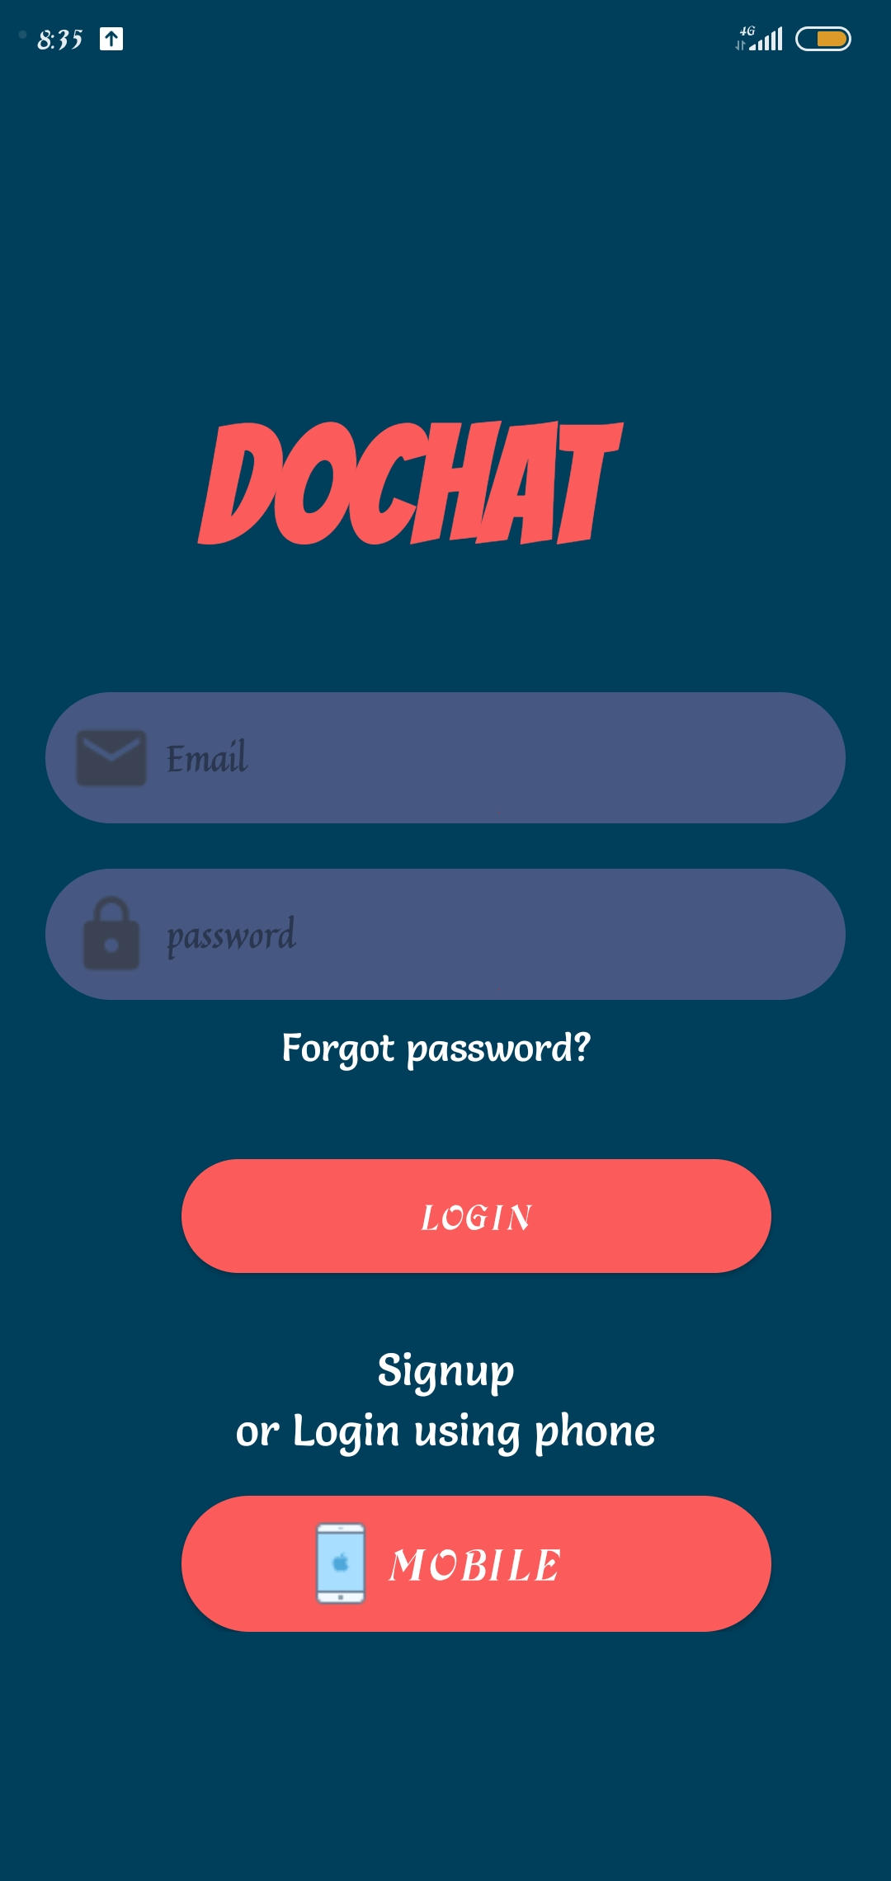
LOGIN
Member can Login via through this module
Member can login with his email id and password.

Slide 10
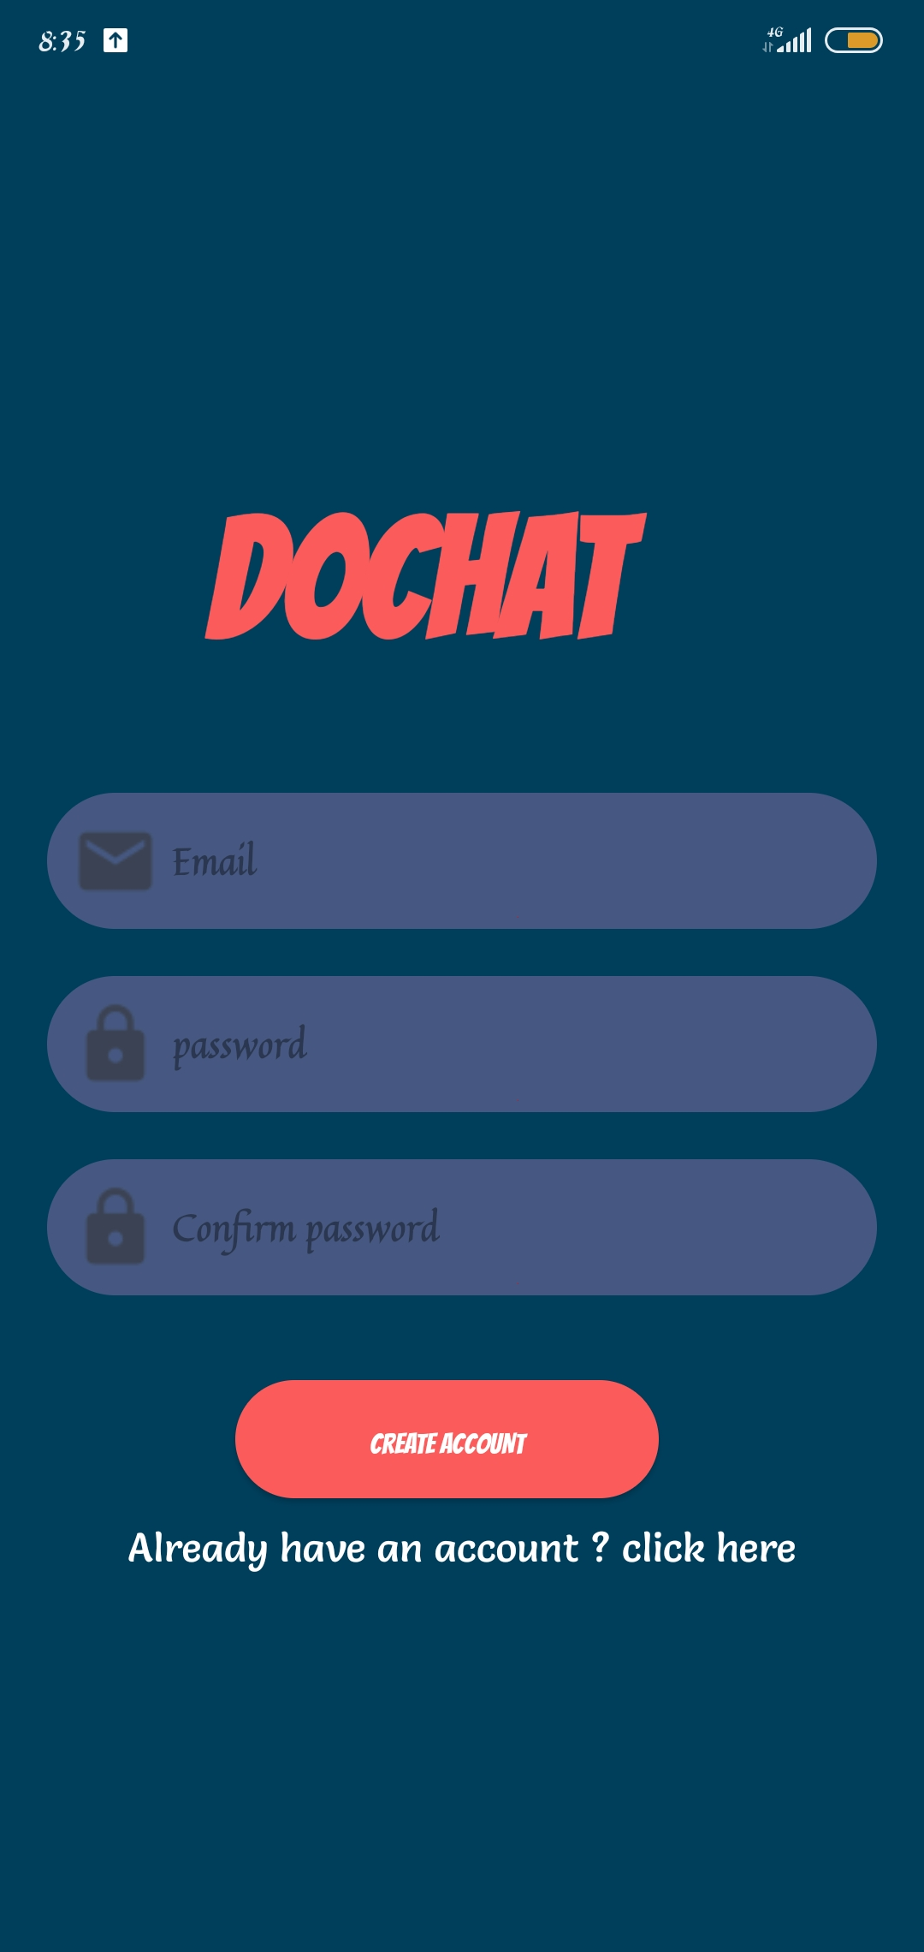
SIGN UP
Anyone new to app can signup.
Anyone can signup using email id and password.

Slide 11
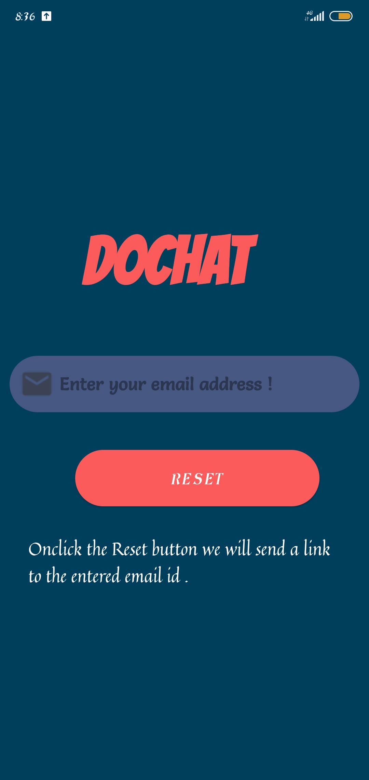
FORGOT PASSWORD
If member forgot his password unfortunately
He can use this module and create new password.
In this forgot password UI onclicking the “Reset” button
Member asked to create a new password via his email.

Slide 12
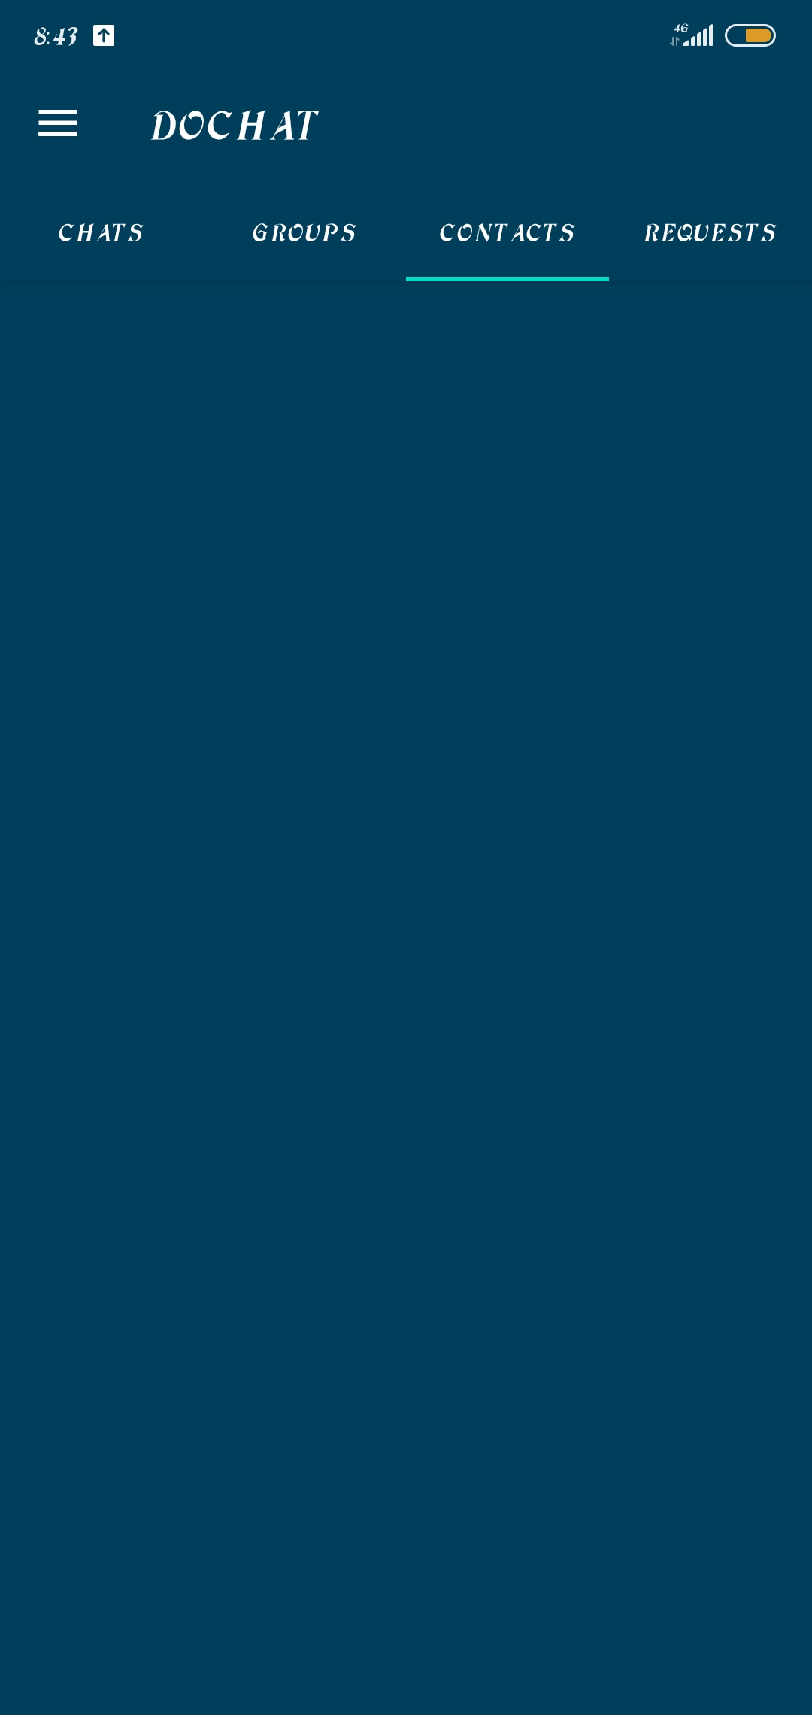
HOME UI
This is the Home UI of dochat application.
It contains four sections namely.
CHATS : It lists all the chat lists of the user.
GROUPS : It lists all the groups in which the user as member.
CONTACTS : It lists the contacts list of the user.
REQUESTS : It lists all the friend requests that came for the user.

Slide 13
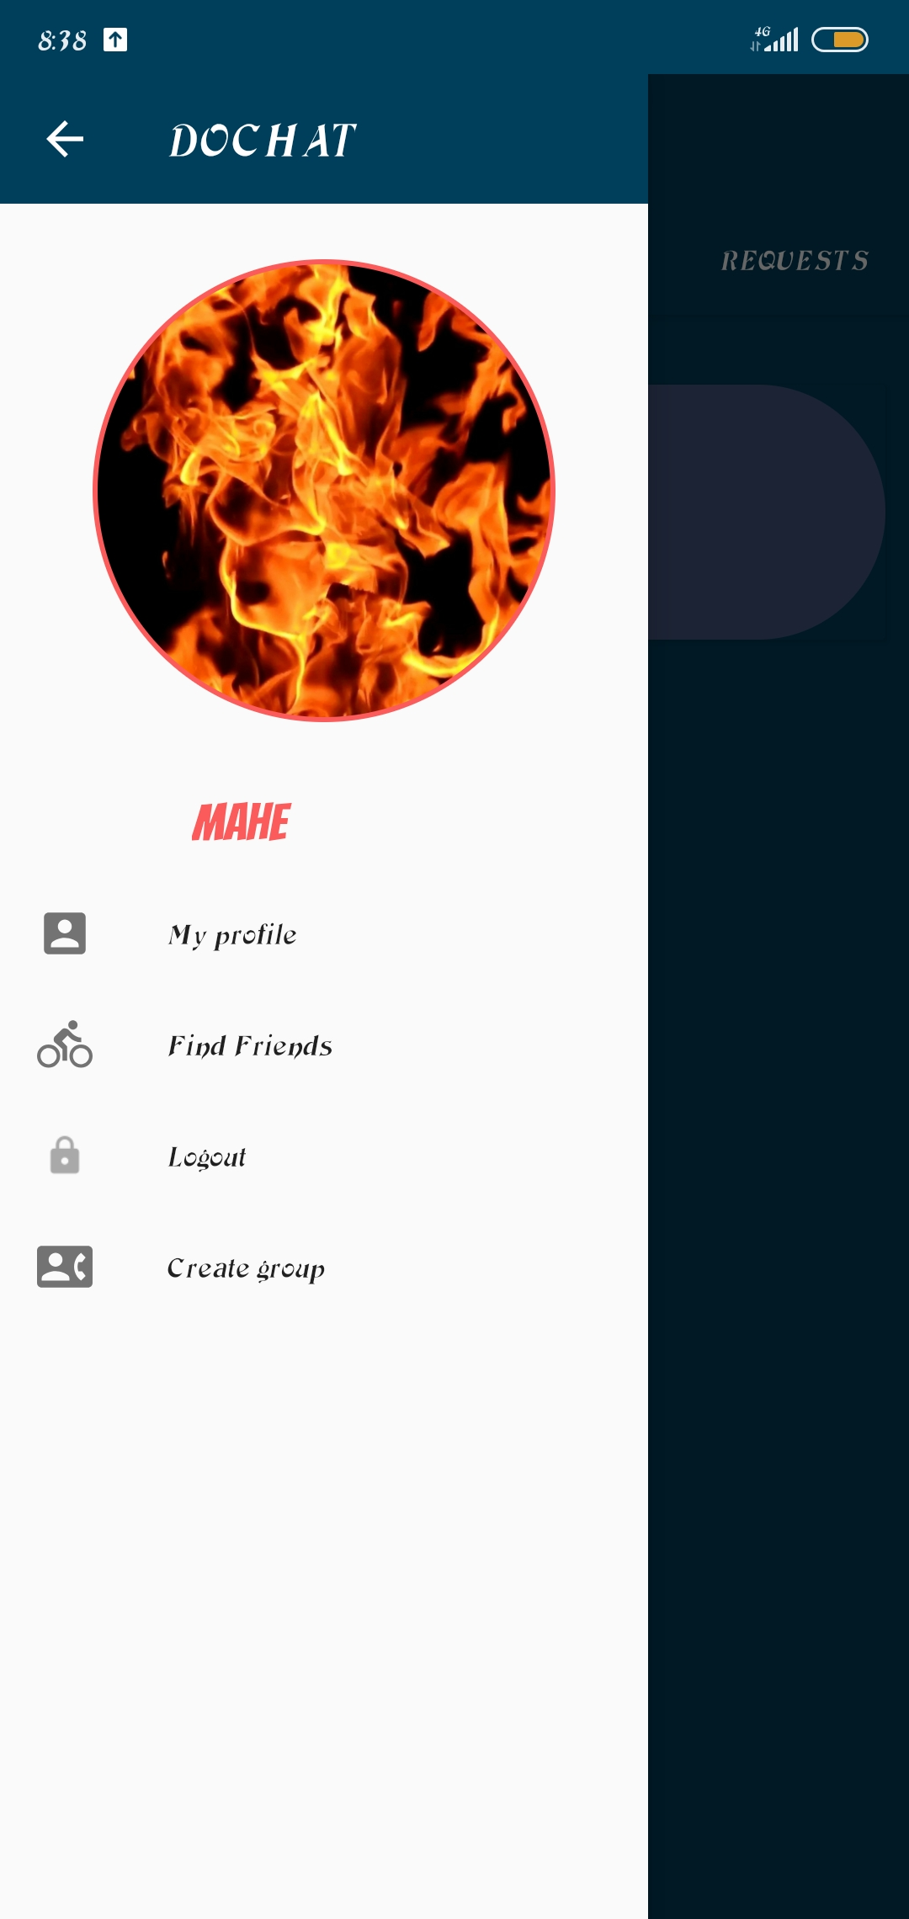
APP MENUS
Dochat application consists of mainly four menuitems.
Namely
My profile : Member can edit his profile.
Find friends : Member can find users those who all are using dochat app.
Logout : Member can logout via this menu.
Create group : Member can create his own group.

Slide 14
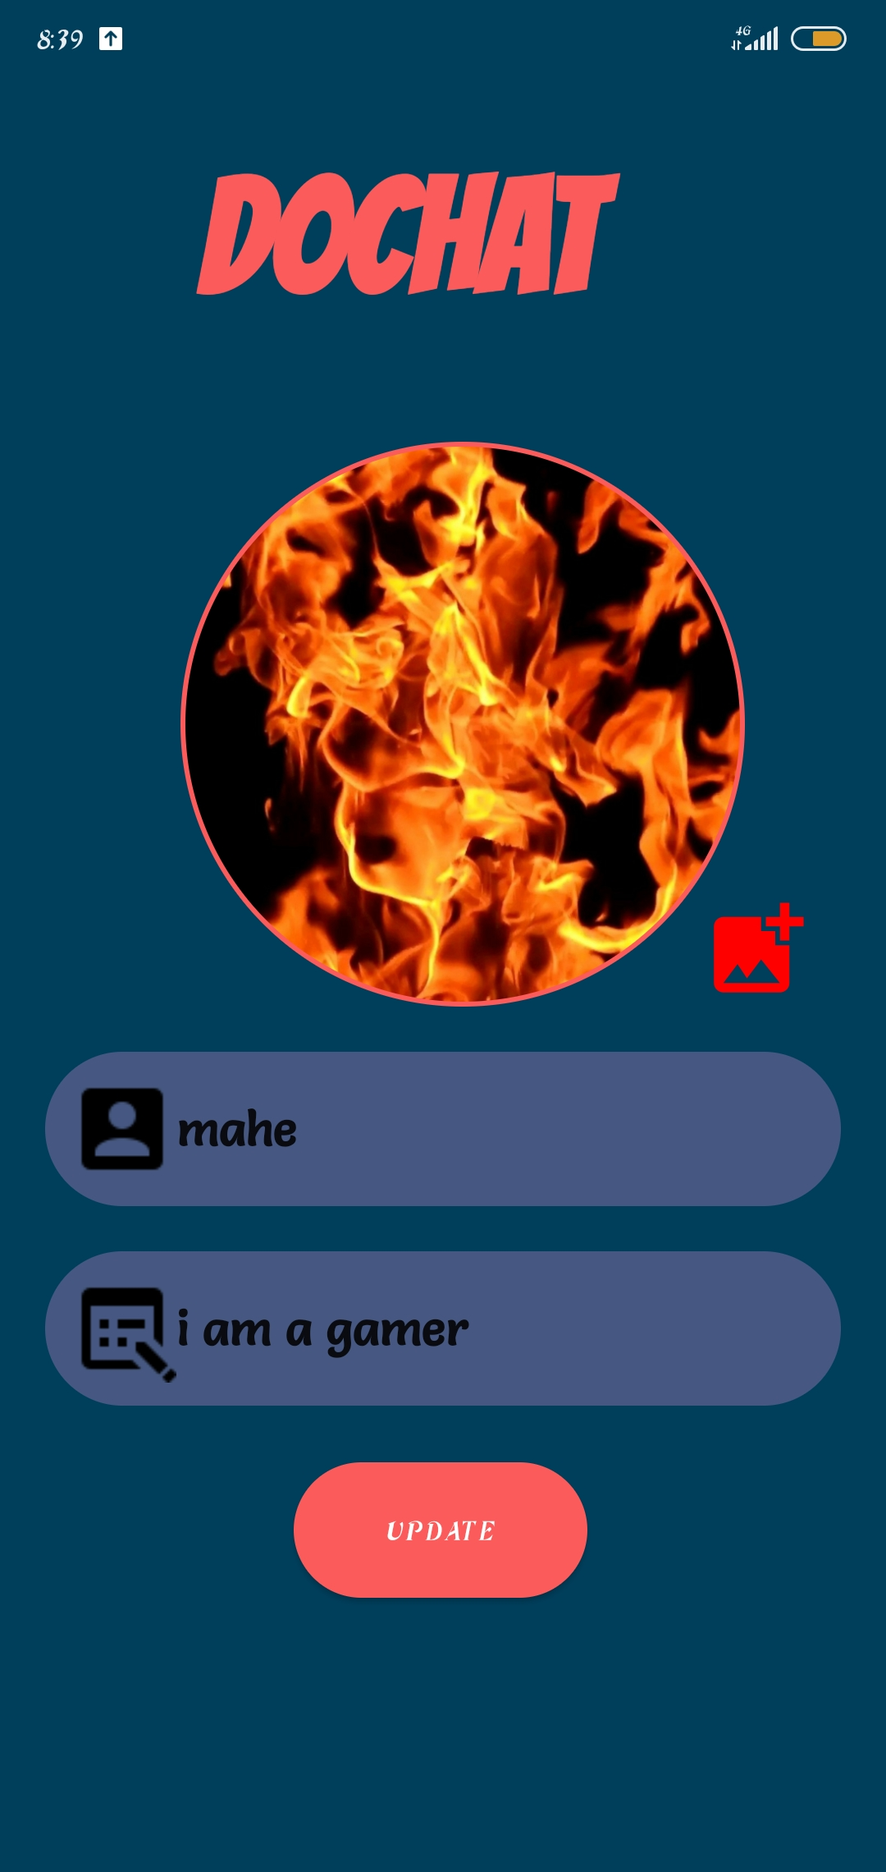
USER PROFILE
Member can edit his profile like
Username , profile picture, about
Via this ‘myprofile’ module.

Slide 15
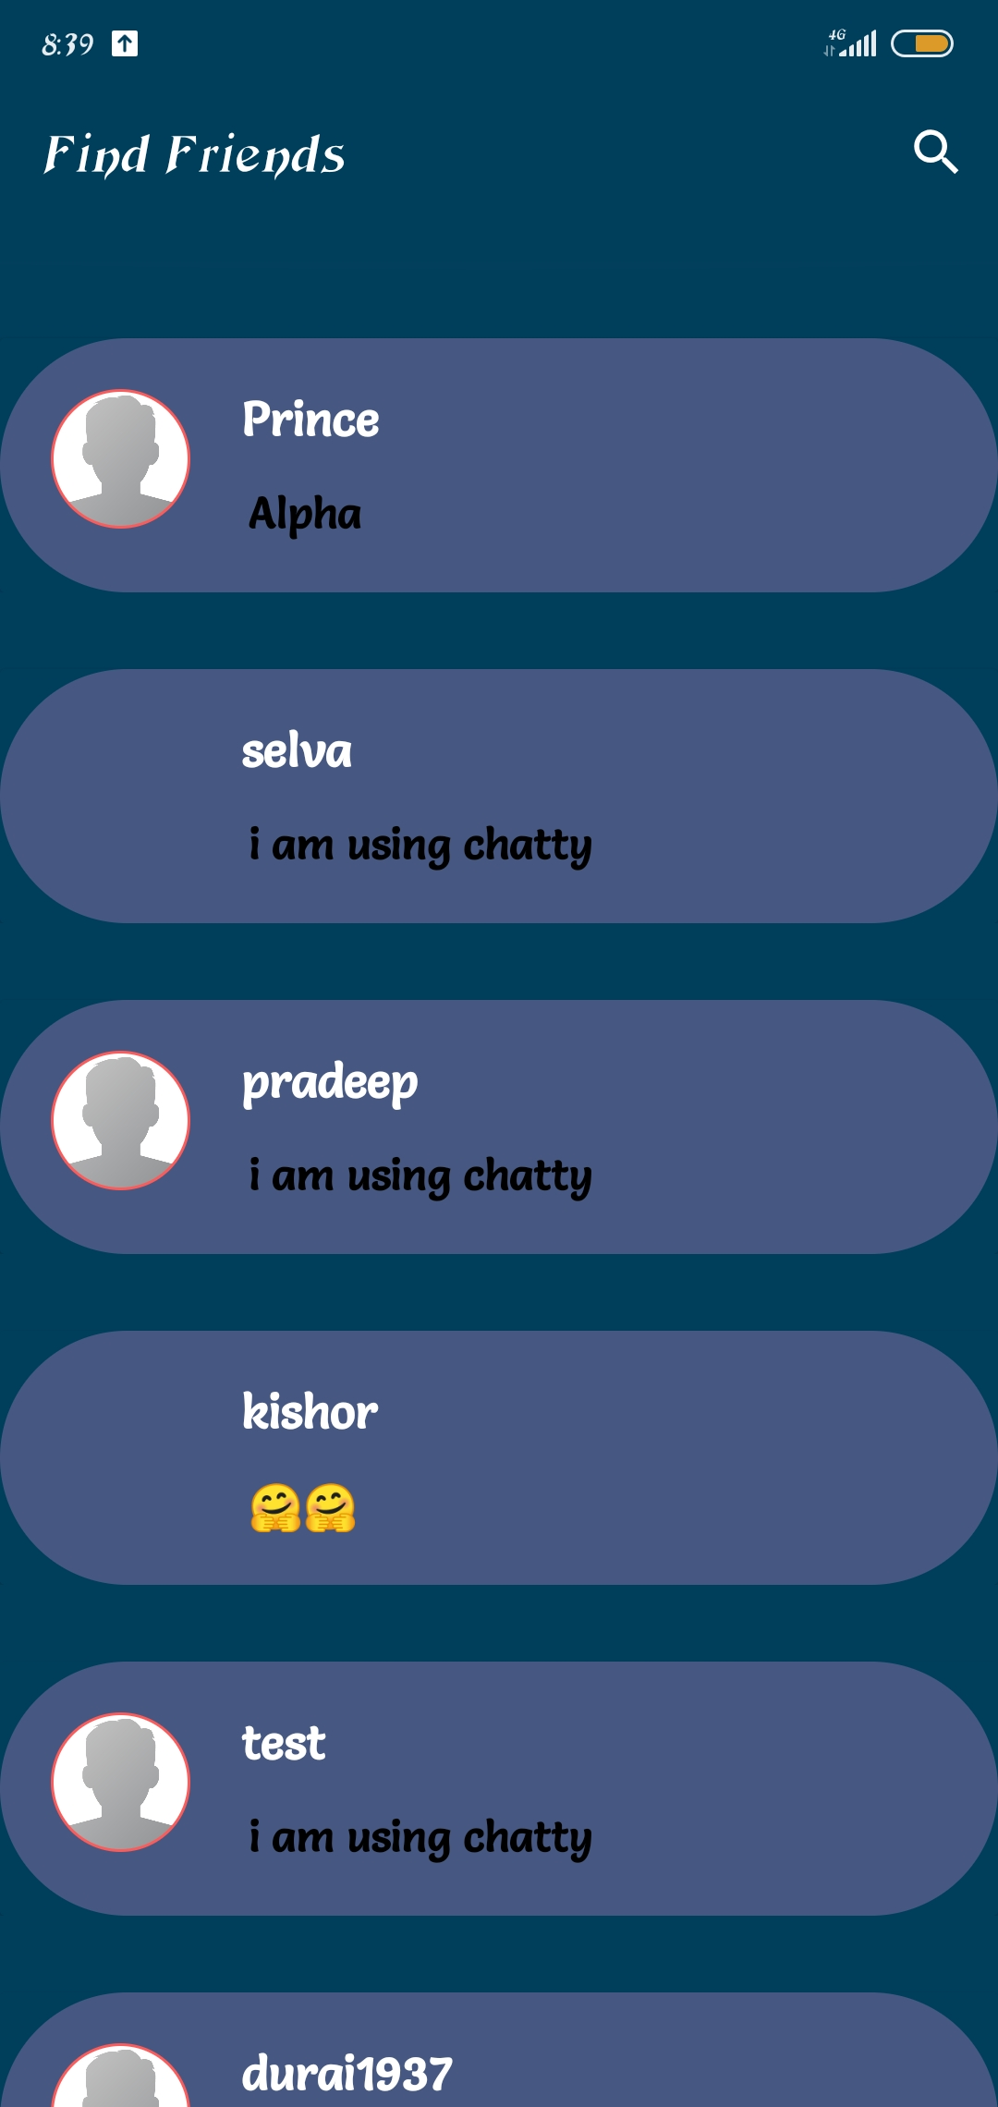
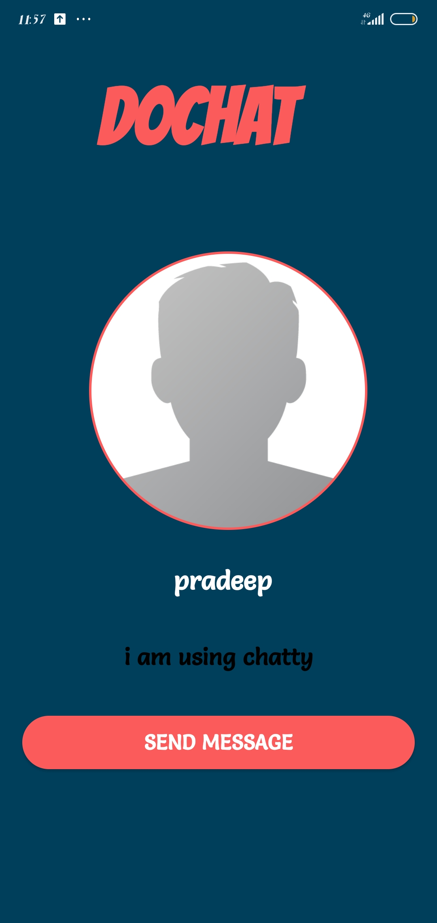
FIND FRIENDS
Member can find friends
Those who are all using DOCHAT application
And can request to them by clicking SEND MESSAGE button

Slide 16
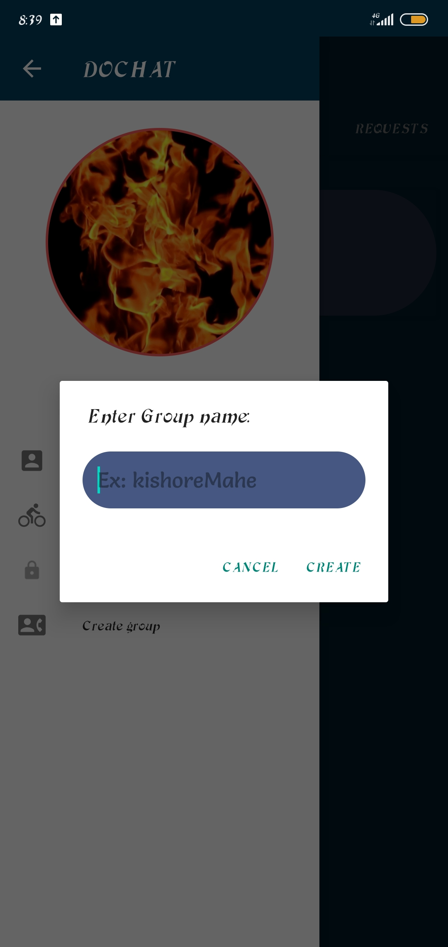
CREATE GROUP
Member can create his own group via this module.

Slide 17
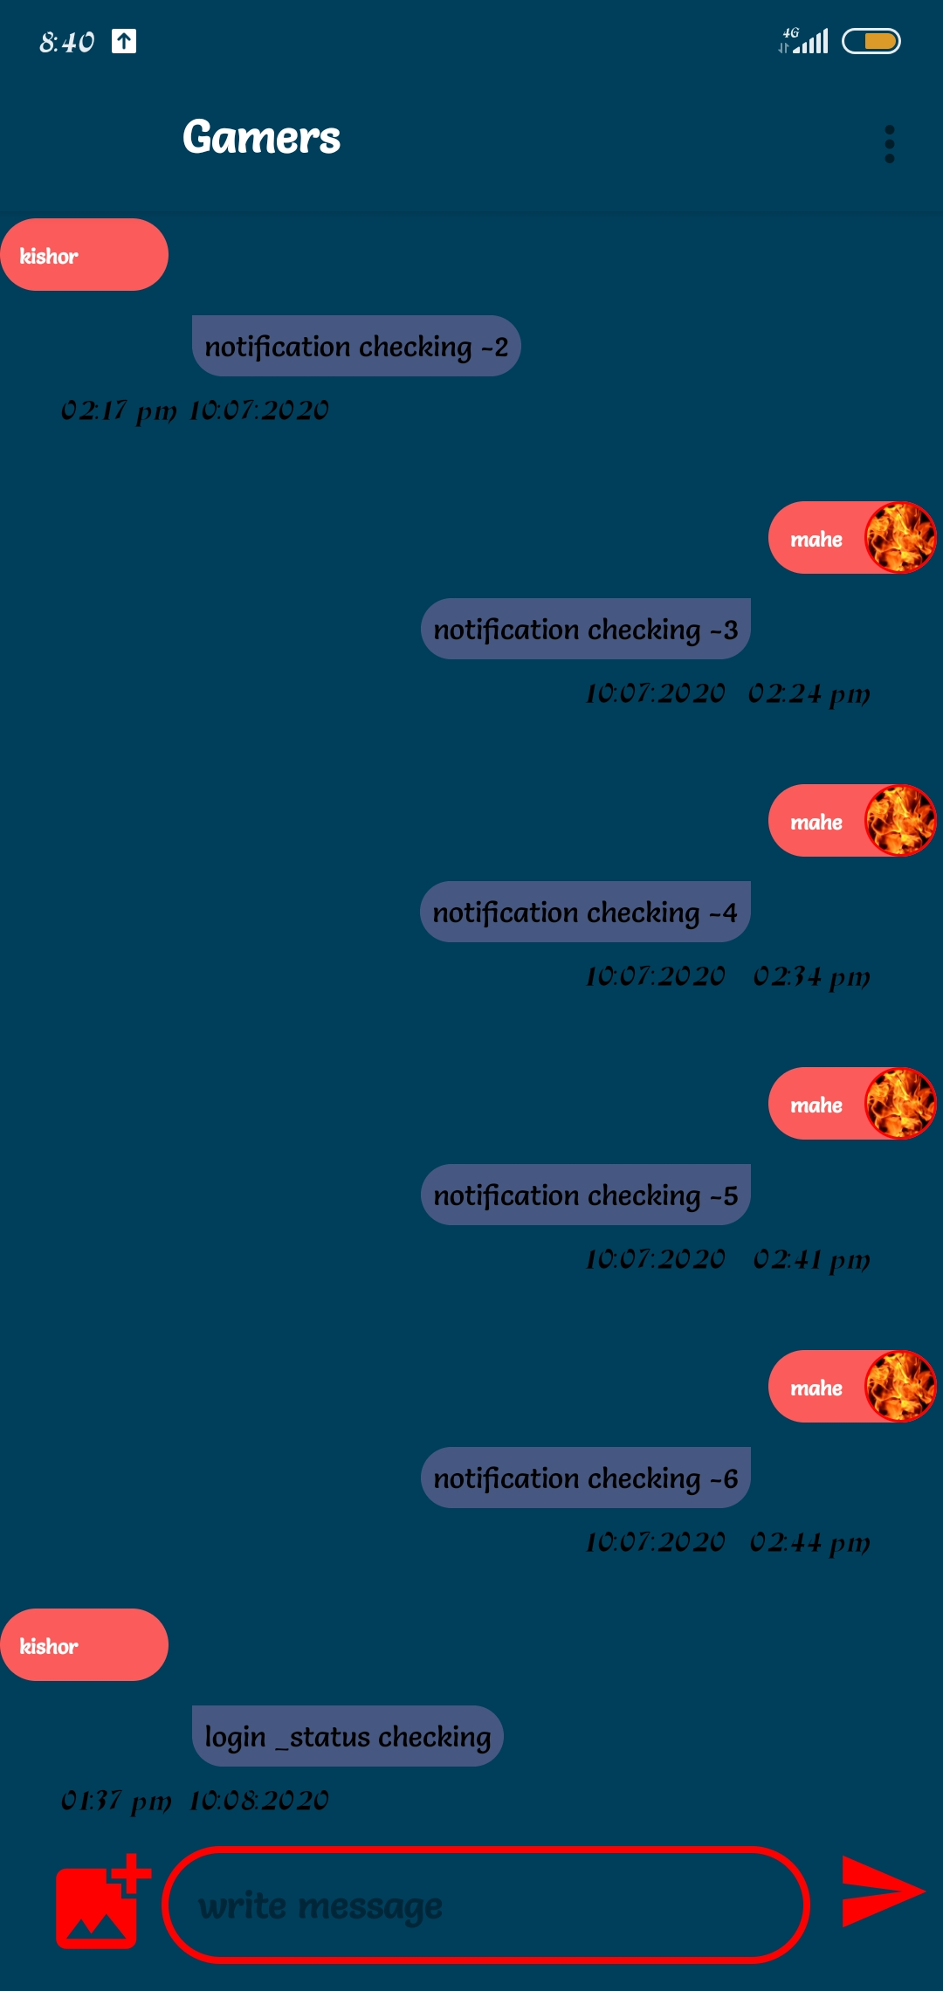
CHAT UI
This is the chat user interface of the
Dochat application where the
Member can send pictures and text.

Slide 18
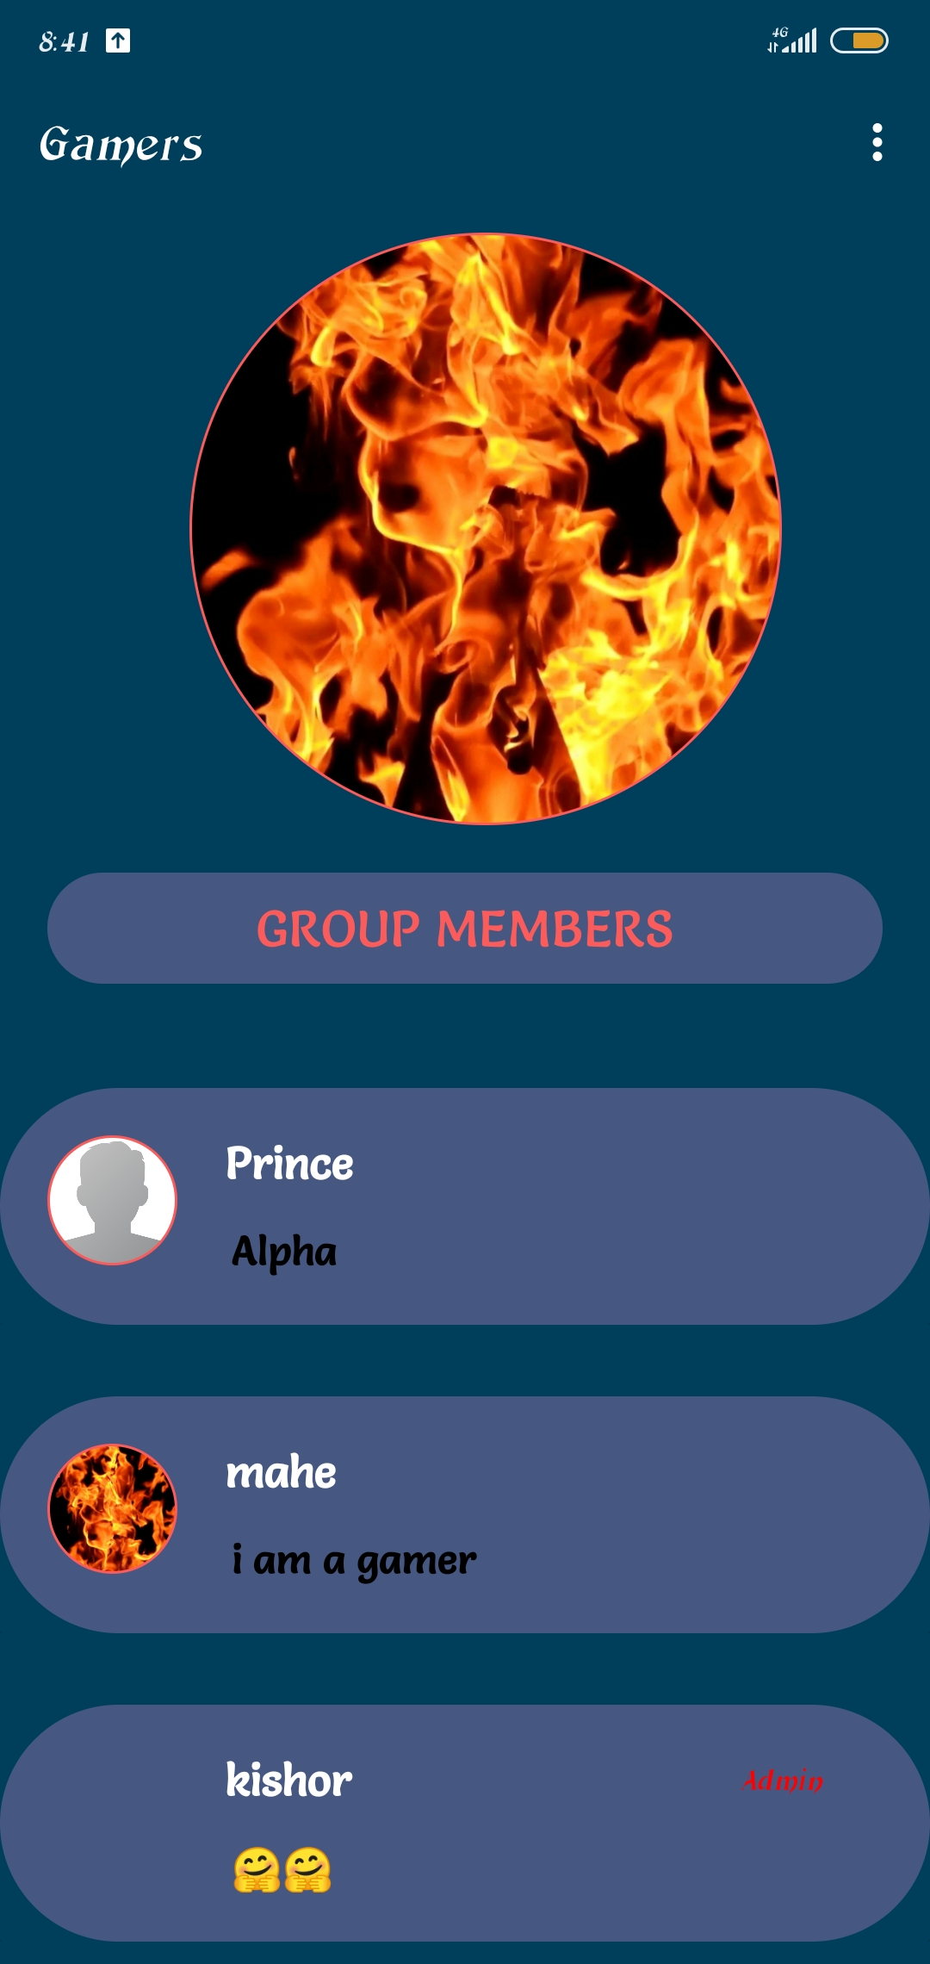
GROUP INFO
Via this module member can view the
List of members in the group
The Admin of the group only can “add” and “remove” users.
Others can’t “add” and “remove” users.

Slide 19
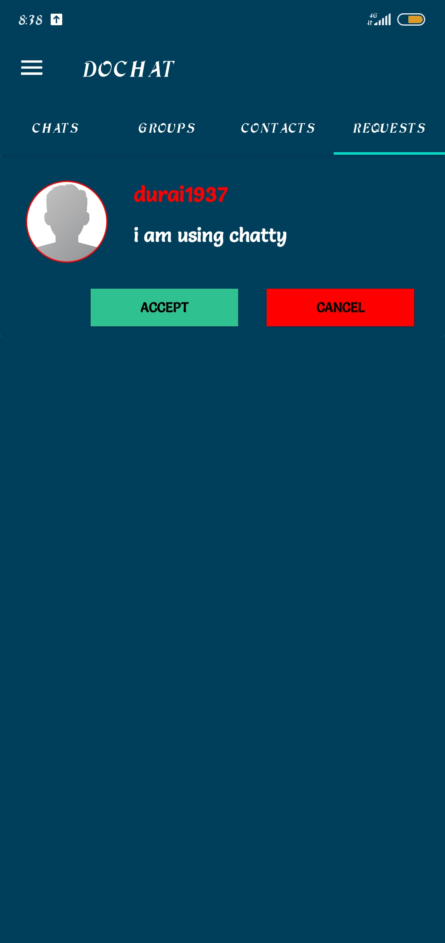
FRIEND REQUESTS
In this section ,The member can view the list of requests that came for him.
He can accept or decline the request.

Slide 20
SOURCE CODE
I have uploaded the source code for the entire project in github.
Link to the “DOCHAT” project source code.
Click here to go the source code

Slide 21
DOCHAT APP INSTALL LINK
Click here to install DOCHAT app.

Slide 22


